Slide 1
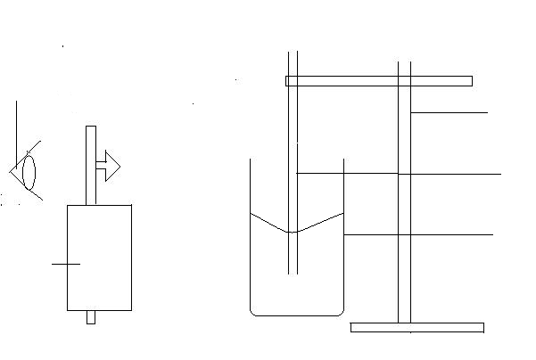
observer
Retort stand
Capillary tube
beaker
Travelling microscope

